Slide 1



TEAM MEMBERS:
A Comparative Study of Student Success and Retention Rates in Pursuing Higher Education
TANMAY SULE
PRERNA DESAI
AKANKSHA WAGH

Slide 2
DATASET EXPLANATION
Let’s get an overview of the data with following the set of slides
1

Slide 3
Develop a robust predictive model using machine learning classifiers for to understand and enhance student success and retention by analyzing factors influencing dropout rates in diverse academic disciplines.
Additionally, our insights will enable institutions to implement targeted interventions and support mechanisms to enhance student retention and academic achievement.
PROBLEM
STATEMENT

Slide 4
DATASET EXPLANATION
This dataset provides a comprehensive view of students in diverse undergraduate programs, covering socio-economic, academic, and demographic aspects at enrollment.
With information on application types, marital status, courses, and economic indicators, it facilitates nuanced analysis of factors influencing academic success and dropout rates.
Researchers should be mindful of variable types, biases, and the dataset's limited timeframe.

Slide 5
DATASET EXPLANATION
(Features present in preprocessed data)
Variables | Description
Course | The course taken by the student.
Gender | The gender of the student.
Age at enrollment | The age of the student at the time of enrollment.
Educational special needs | Whether the student has any special educational needs.
Scholarship holder: | Whether the student is a scholarship holder.
Displaced: | Whether the student is a displaced person.

Slide 6
DATA PREPROCESSING
Let’s start with the preprocessing set of slides
2

Slide 7
DATA PREPROCESSING
STEP 1
STEP 2
STEP 3
STEP 4
STEP 5
Consolidating data into a single and concise data frame.
Cleaning the dataset by removing duplicate columns and handling missing values.
Finding the correlation between columns and visualizing the data.
Modeling, identifying important features
Fine tuning the model to increase the accuracy

Slide 8
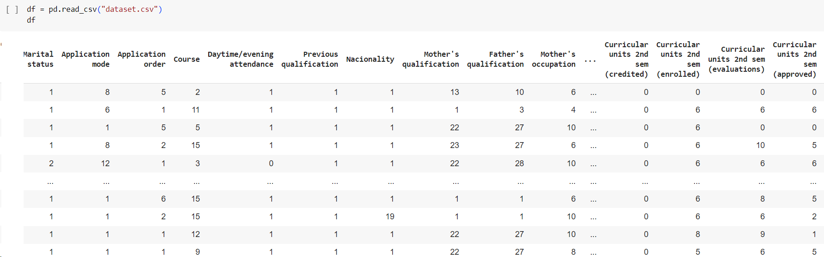
RAW DATA

Slide 9
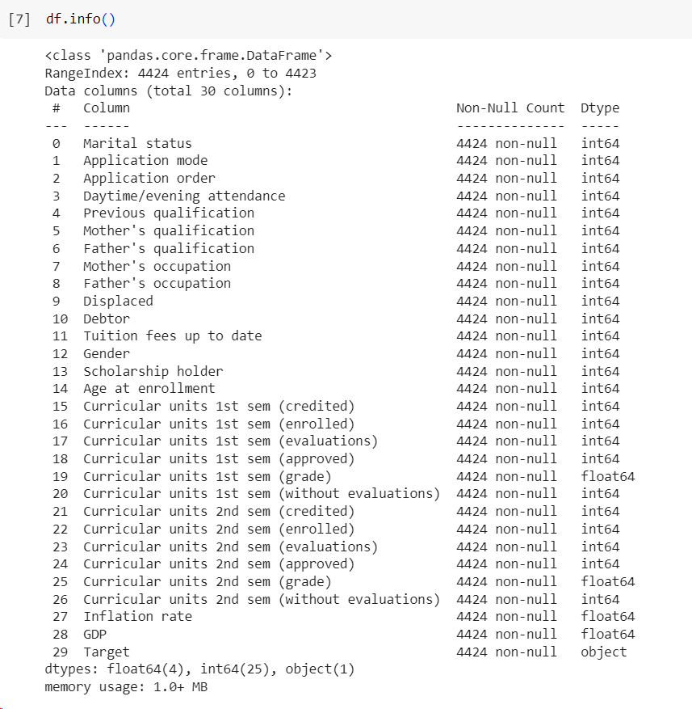
INFO ABOUT DATASET

Slide 10
EXPLORATORY DATA ANALYSIS
Understanding the general trend of data with this set of slides
3

Slide 11
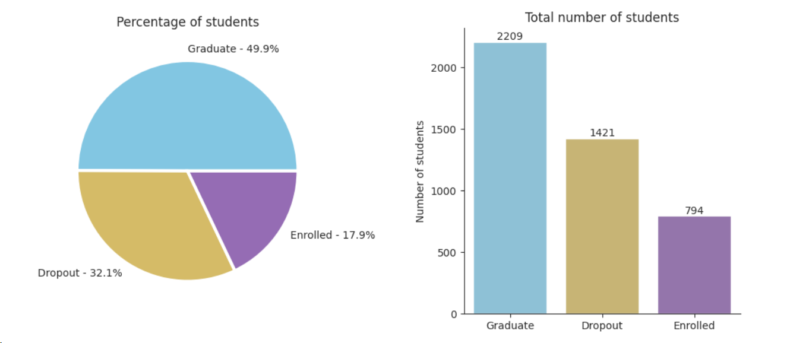
TOTAL NUMBER OF STUDENTS

Slide 12
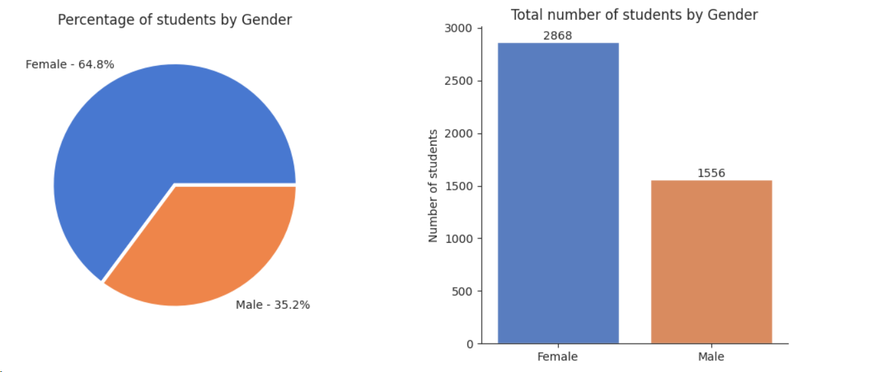
PERCENTAGE OF STUDENTS BASED ON GENDER

Slide 13
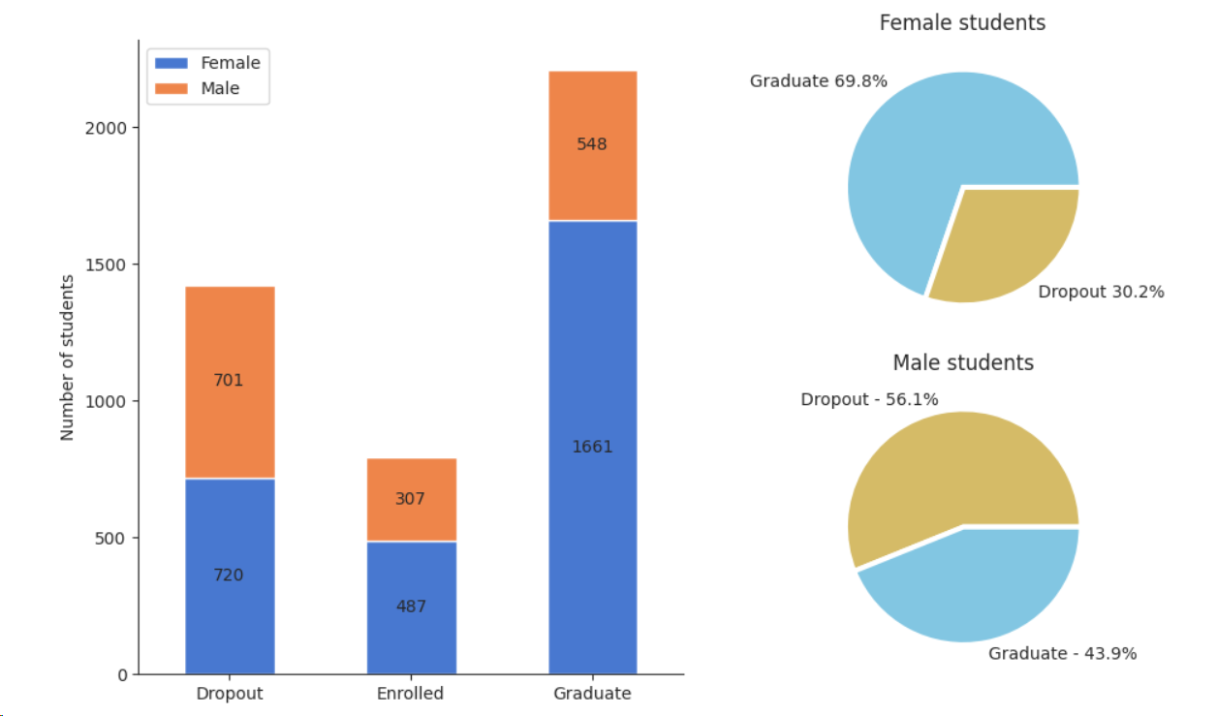

Slide 14
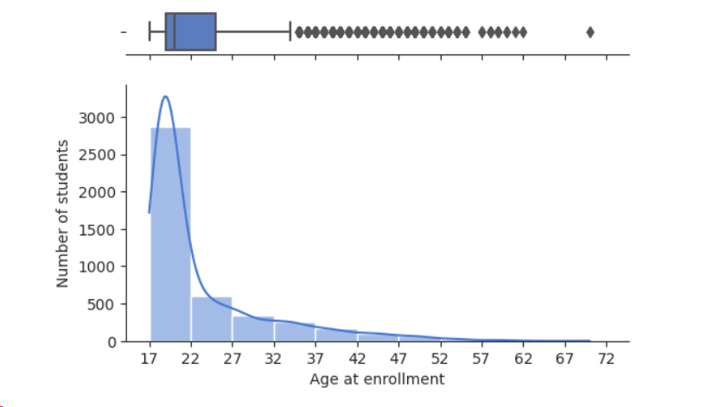
STUDENTS BASED ON AGE

Slide 15
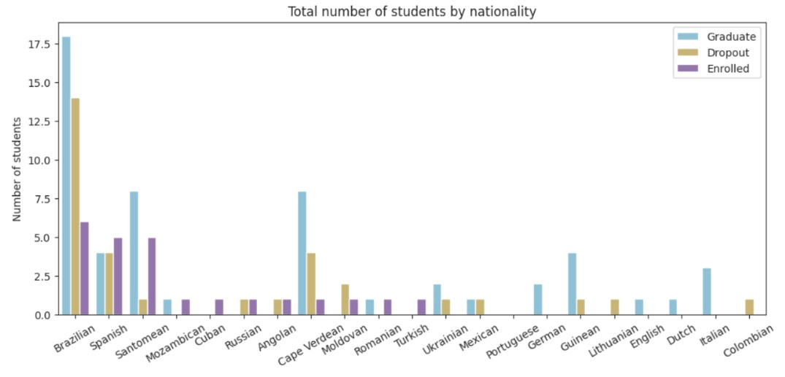
TOTAL NUMBER OF STUDENTS BY NATIONALITY

Slide 16
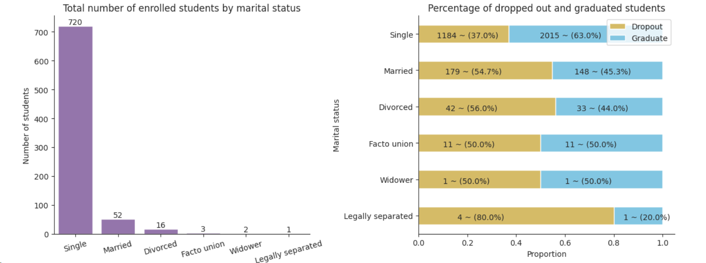
STUDENTS BASED ON MARITAL STATUS

Slide 17
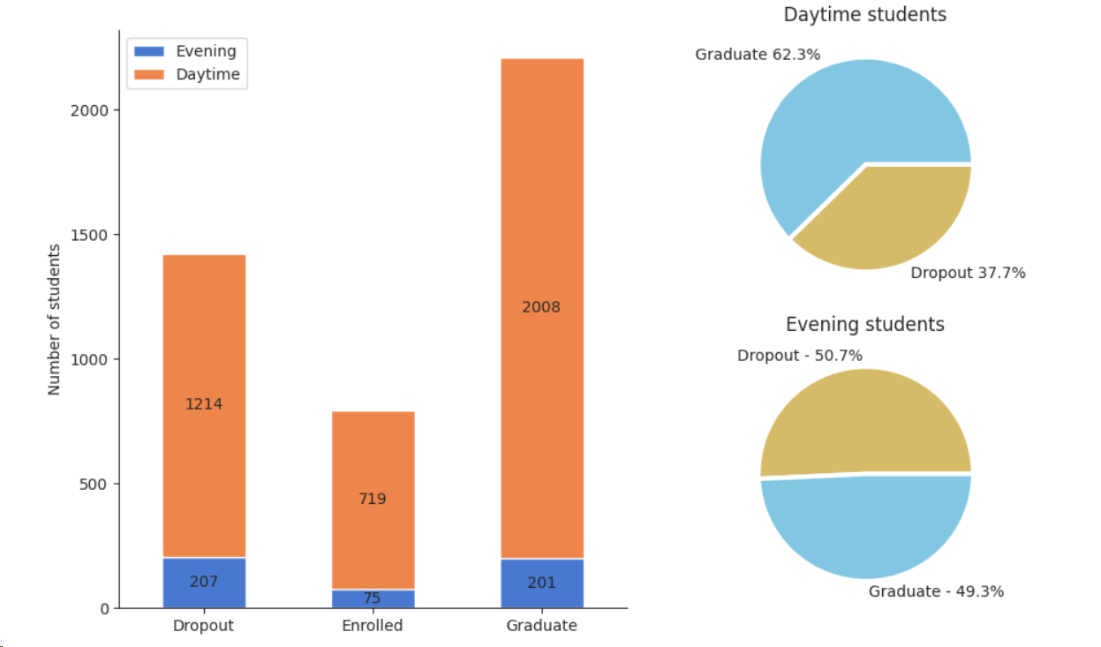
STUDENTS BASED ON CLASS TIME

Slide 18
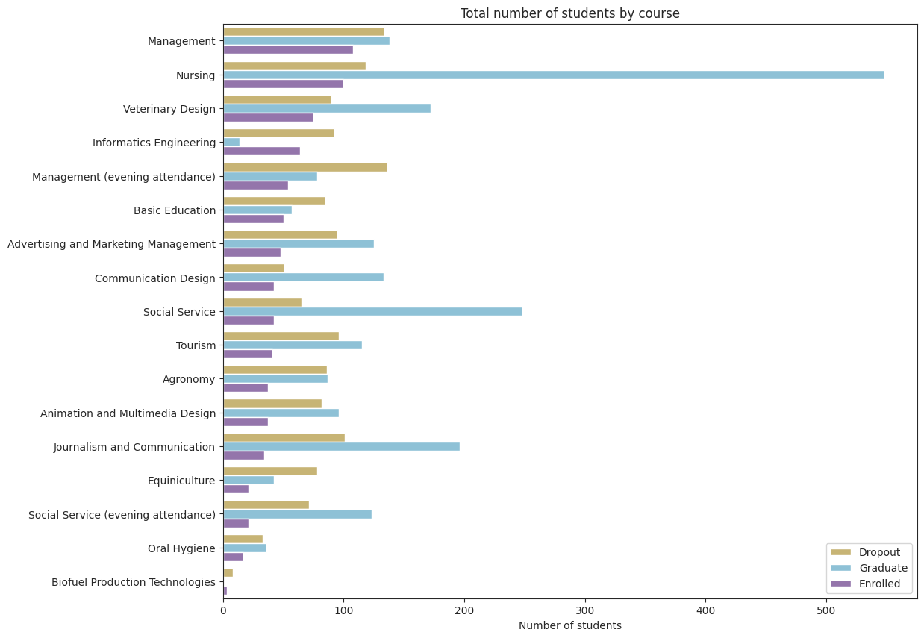
TOTAL NUMBER OF STUDENTS BY COURSE

Slide 19
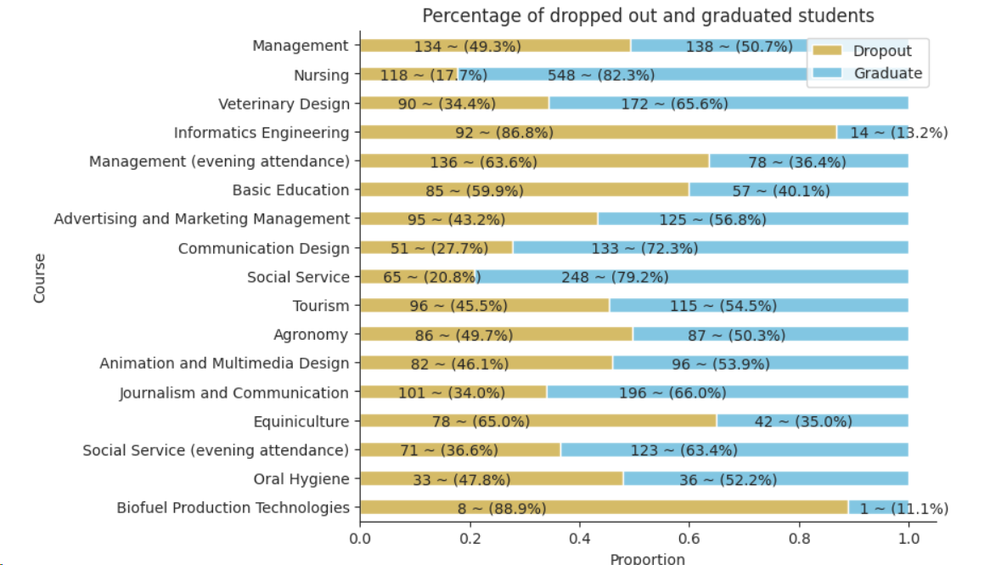
PERCENTAGE OF DROPPED AND GRADUATE STUDENTS

Slide 20
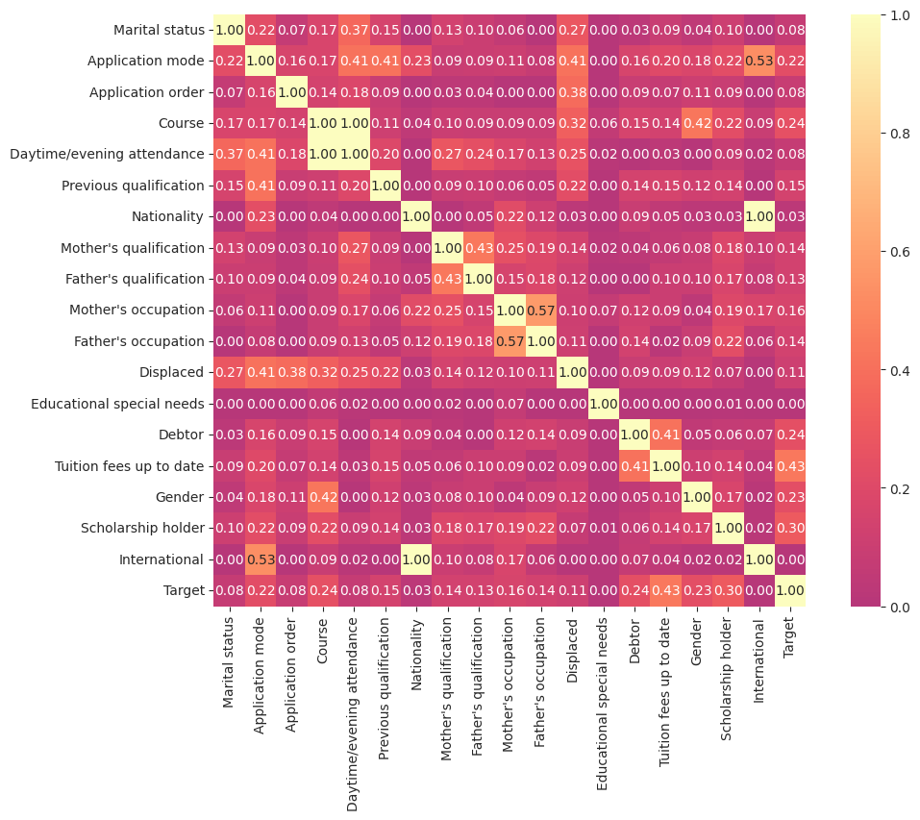
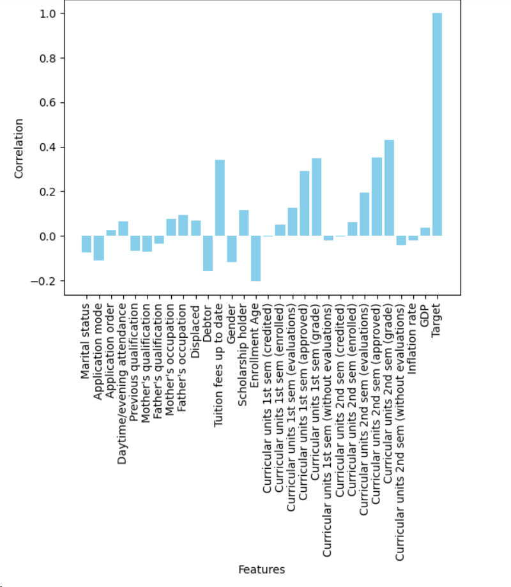
CORRELATION MATRIX

Slide 21
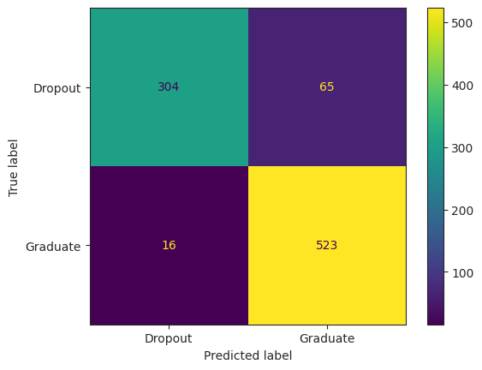
CONFUSION MATRIX

Slide 22
MODEL EVALUATION
The following set of slides deal with evaluating and comparing the
Classifiers employed.
4

Slide 23
Classification Algorithms
Gradient Boosting
Decision Tree
Support Vector Machine
Random Forest
Logistic Regression
Different Classification Algorithms used and their results

Slide 24
Classification Models
MODELS | Precision | Recall | F1-SCORE | ACCURACY
Gradient Boosting | 90% | 95% | 92% | 91%
Decision Tree | 90% | 89% | 89% | 87%
SVM | 86% | 98% | 92% | 89.5%
Random Forest Classifier | 88% | 96% | 92% | 91.1%
Logistic Regression | 89% | 97% | 93 | 90%

Slide 25
FUTURE SCOPE
The following slide will highlight some exciting future goals.
5

Slide 26
Future Scope
The analysis of Student Dropout and Retention data and the insights gained can lead to several potential future scopes and directions for this project:
Our project delves into student success and retention intricacies to improve education.
Despite data constraints, strategic decisions were made to prevent overfitting, excluding crucial features.
Acknowledging human factors' complexity, the dataset provides valuable insights for fostering student success and retention.

Slide 27
CONCLUSION
Random Forest gives better accuracy as compared to any other algorithm with little over 91%.
These are the values for following parameters: Precision: 0.889, Recall: 0.970, F1 Score: 0.928.
6

Slide 28
Conclusion
Few parameters in the dataset had negative Correlation. When two variables have an inverse correlation, or negative correlation, one variable rises as the other falls, and vice versa.
This relationship describes an observable pattern; it may or may not indicate that the two variables are causally related.
So, we dropped those columns to get highly correlated data whcih will increase the accuracy of our model.

Slide 29
THANK YOU!

